Slide 1
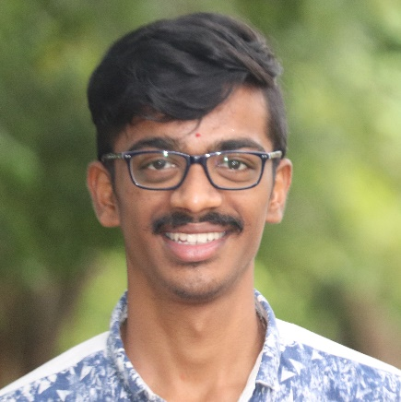


SWARAJ GOVIND S
Analyst/Software Engineer
BACHELOR OF TECHNOLOGY
Mechanical Engineering:2017-2021
Skills C#
Dot net core
ADO. Net
ASP. Net Core MVC
DatabaseL
MS SQL Server 2014
Web Technologies
HTML5
CSS3
Javascript
AddOns
Github
Postman
Additional skills
Leadership Qualities
Quick Learner
Team Management
BANGALORE
swarajgovind.s@capgemini.com
+91 7353500693
A4
Eager to work in a team of dedicated people and serve a key role in the enhancement and development of the project.
Software Engineer who is Strong in design and integration with intuitive problem-solving skills. Passionate about implementing and launching new projects.
Ready to learn new technologies and implement them to further improve my knowledge.
Has working knowledge on Angular and Java Microservice Development using Spring framework on an intermediate level.
Online Learning Management System :
Completed end to end case study of Online Learning management System along with JWT authentication, Swagger. html, CSS, JSused for user interface.
Microsoft Azure Fundementals Certificate :
Completed this course with 80.5.
Check out my work on GitHub & Video Profile

